Slide 1
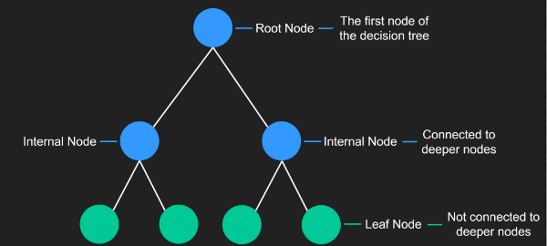
A decision tree is a type of supervised machine learning model. which can be used for both regression and classification as well. It is one of the most powerful models used for the complex dataset.
The decision tree coupled with an ensemble technique. The process of dividing the data set in the tree-structured format based on some rules and condition and finally provide the prediction based on the condition.
Here is basic structure of Decision tree where top node is called as root node and bottom node is know as leaf node. All node between root and leaf node are the internal node. Lines are generally called as branches.

Slide 2
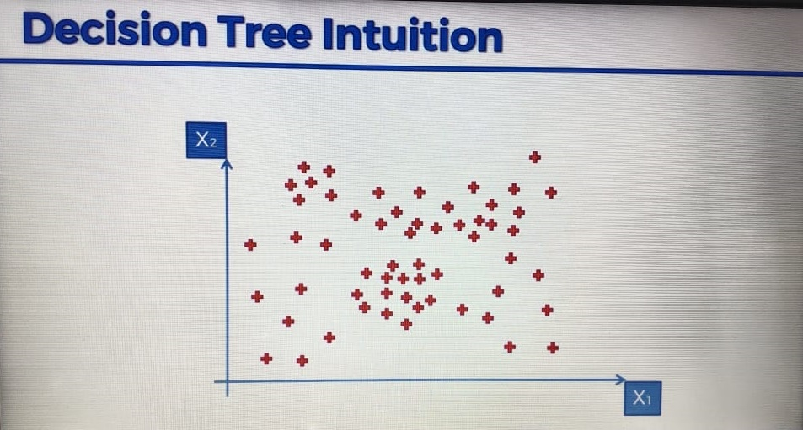
Decision tree as a regression
Decision tree as a regressor create split into data by creating branches which provide highest amount of information gain and minimum entropy.
Consider data given below here

Slide 3
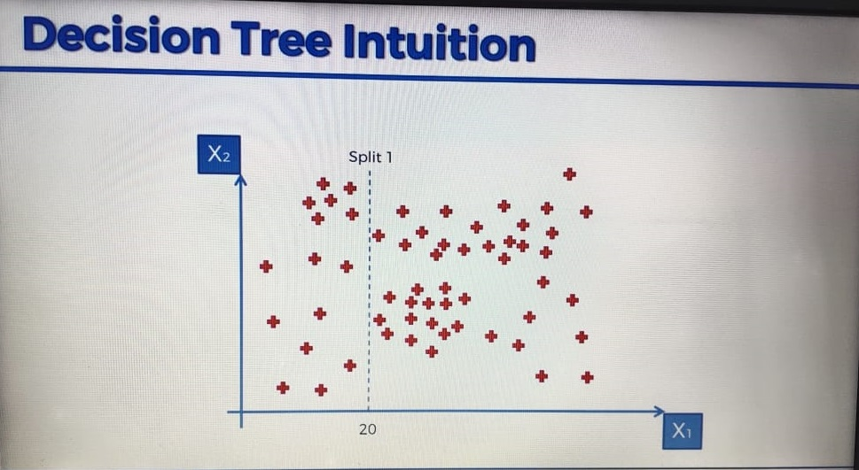
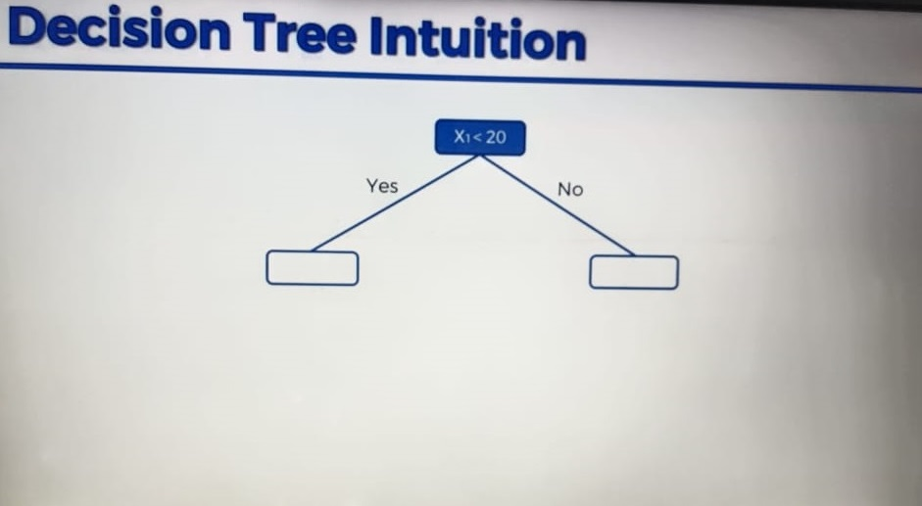
Here we start splitting base of on condition discussed earlier.

Slide 4
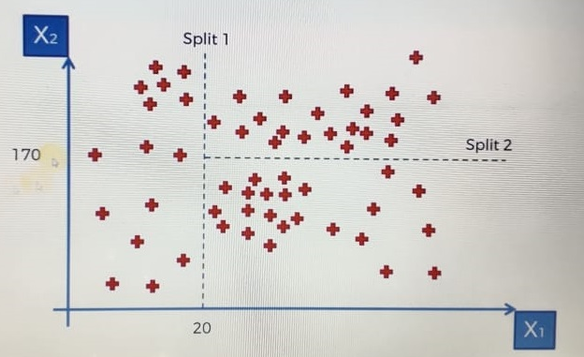
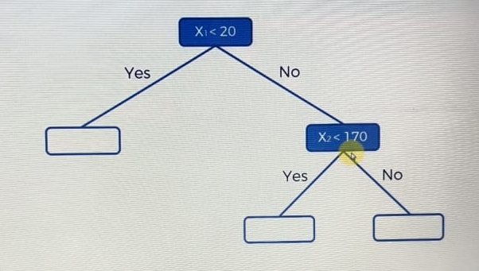

Slide 5
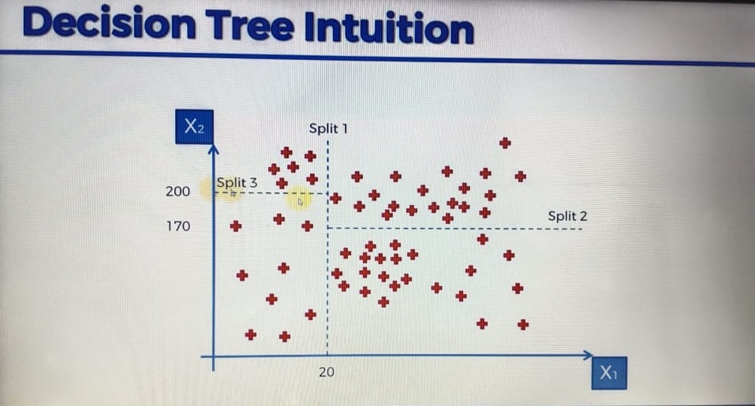
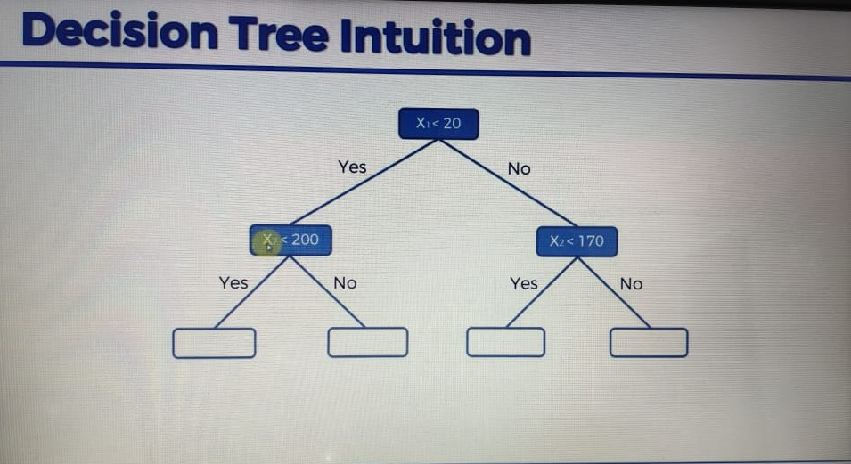

Slide 6
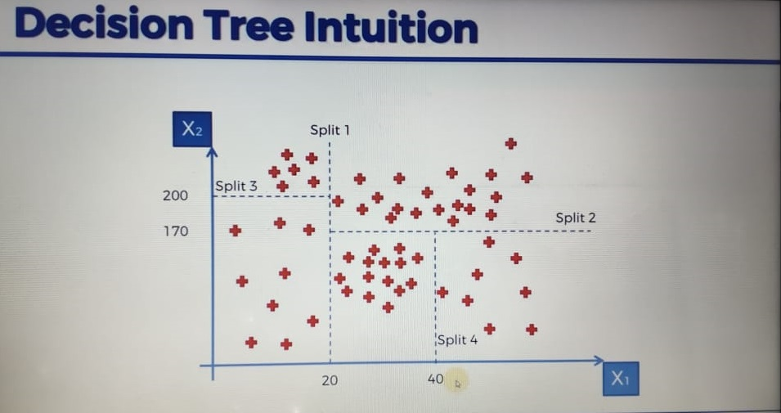
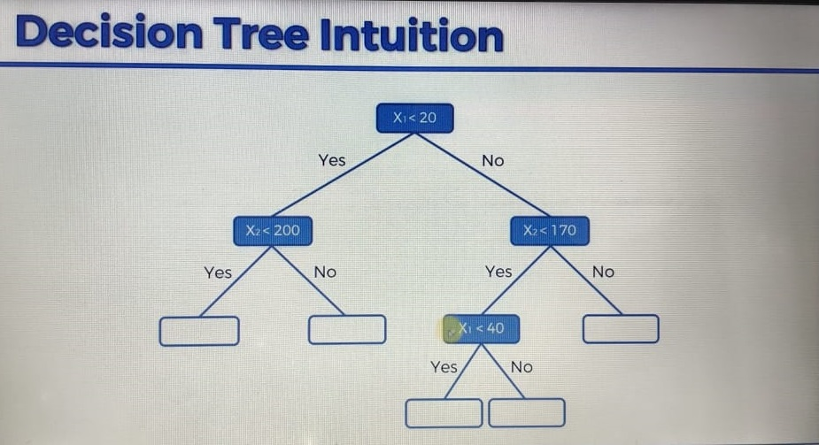

Slide 7
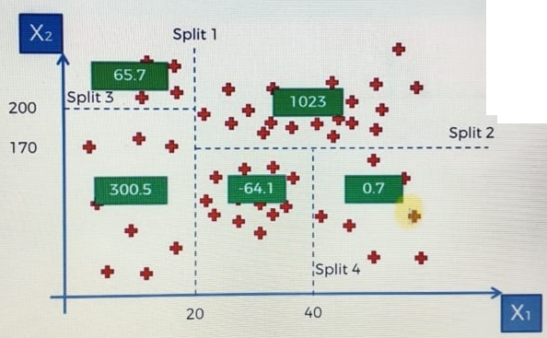
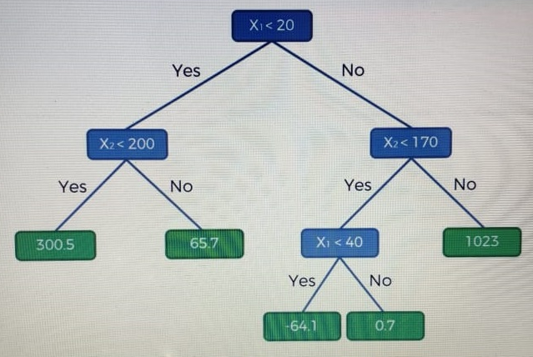
After successfully creating entire tree it will take mean value of each split and respectively it give those value to the each leaf node. And it will take decision from leaf node for any new input.

Slide 8
Now let’s find out value of output for x1= 10 and x2 = 30.

Slide 9
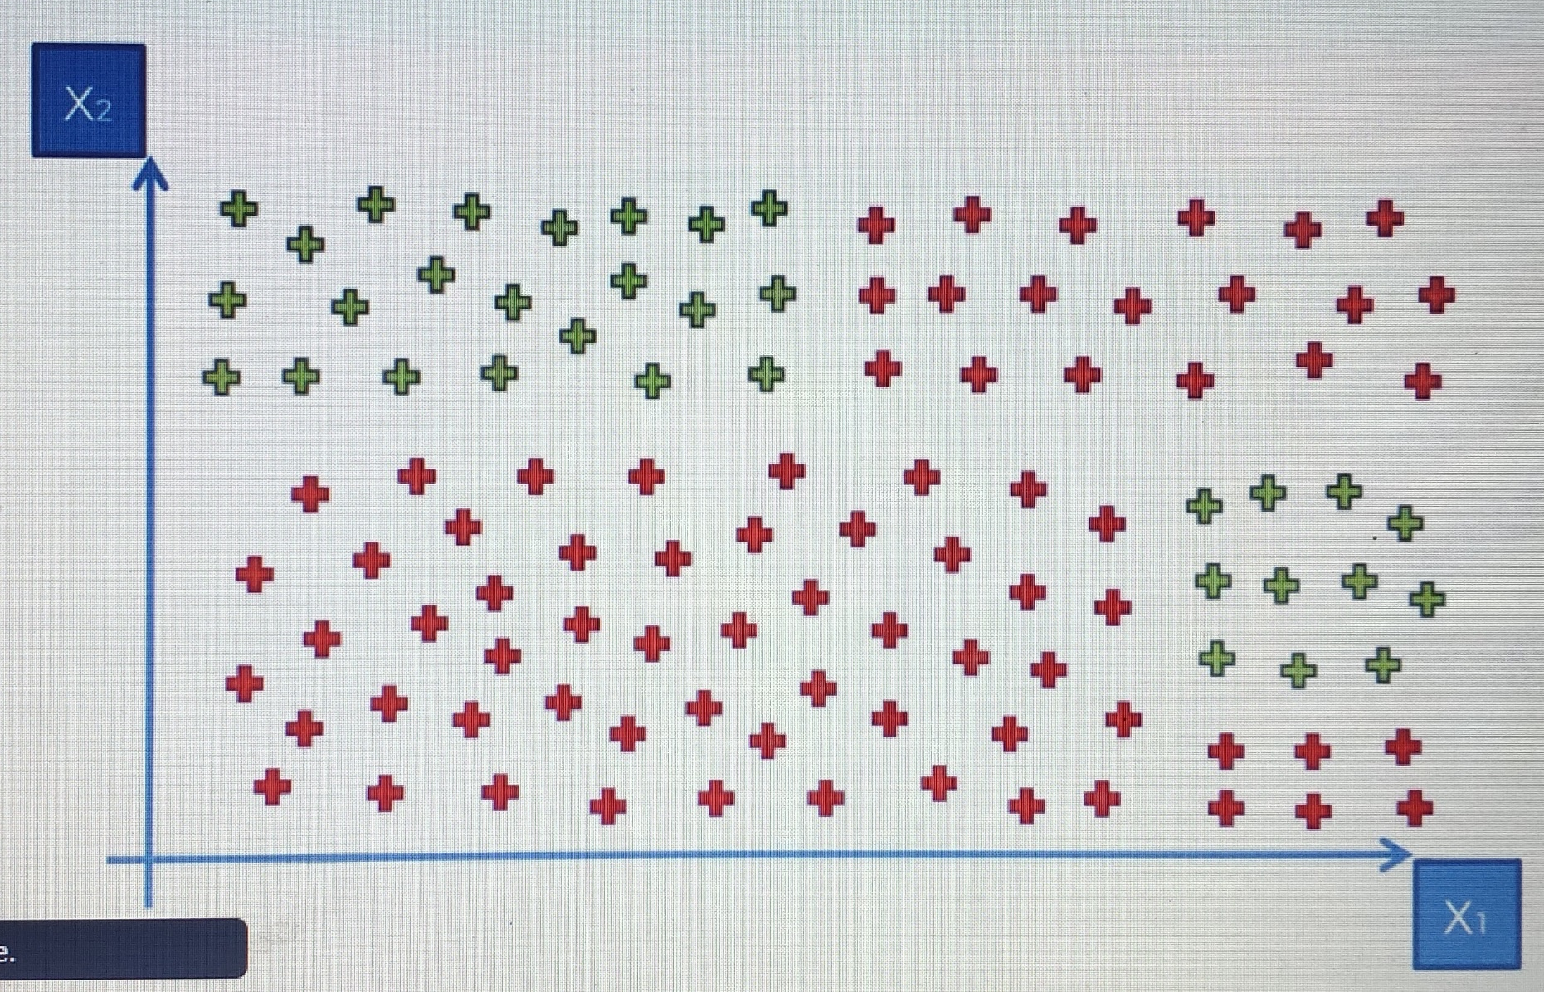
Decision tree as classifier
Decision tree classifier work almost same as decision tress regressor here branches is created which provide highest amount of information gain and minimum entropy. Consider data below.

Slide 10
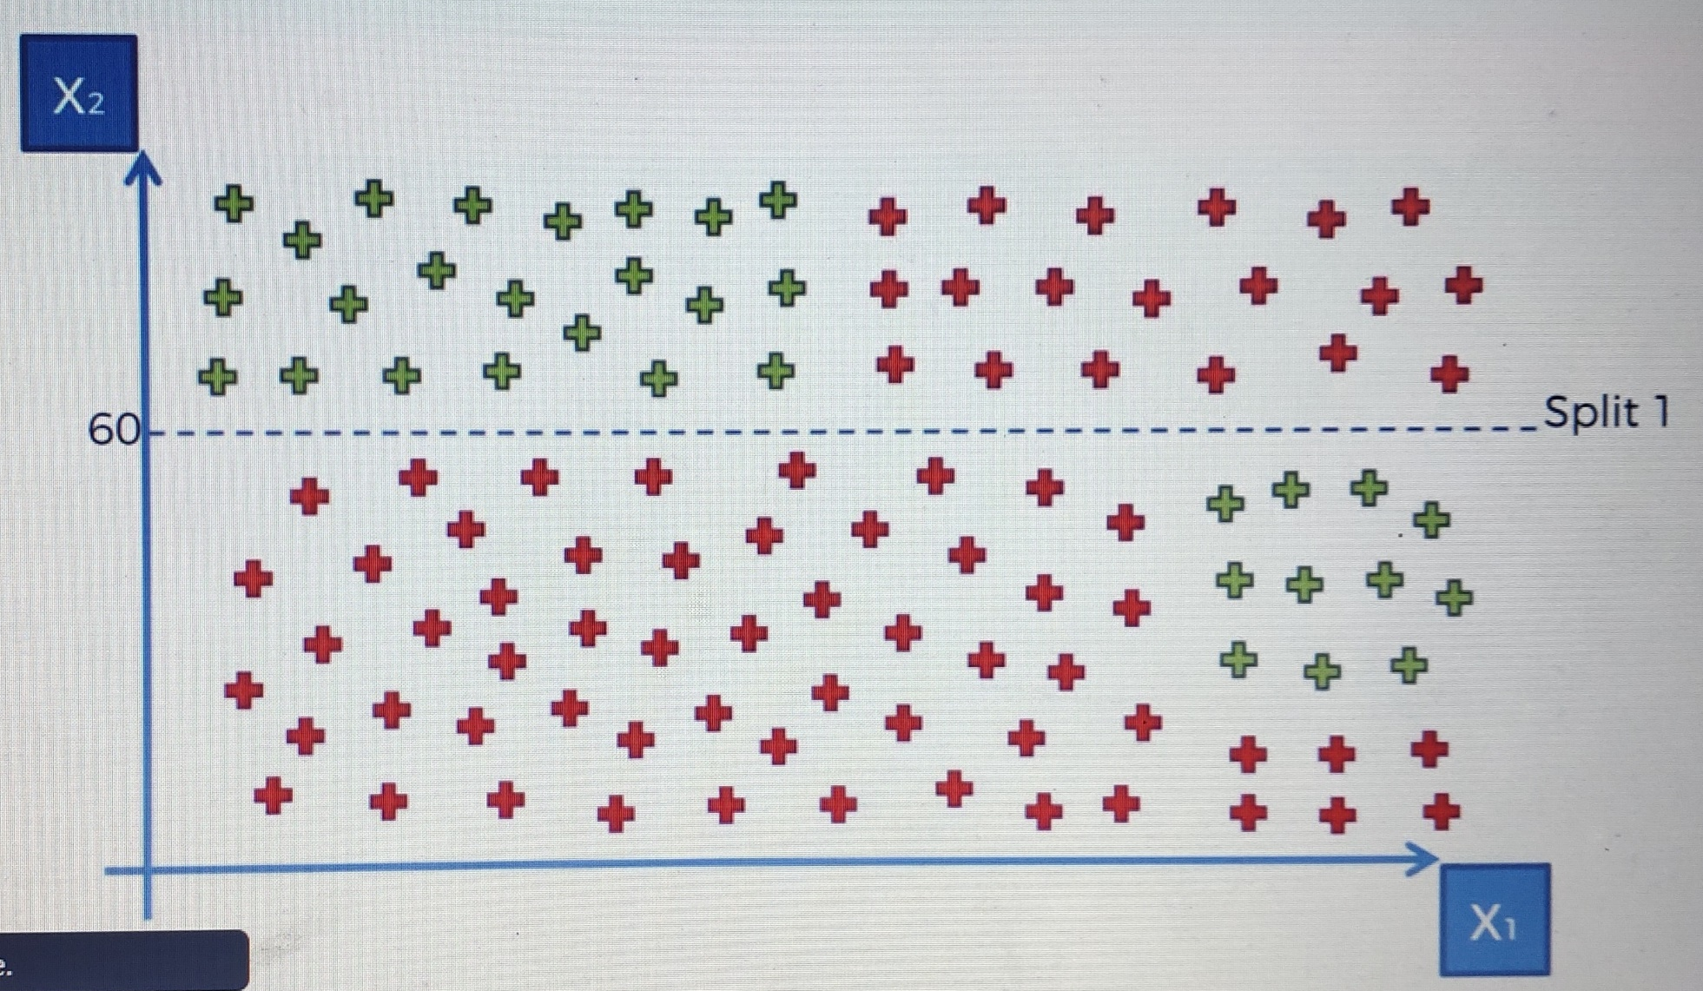
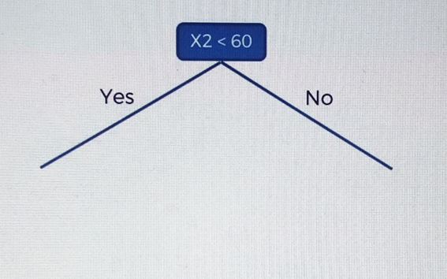
Here we start splitting base of on condition discussed earlier.

Slide 11
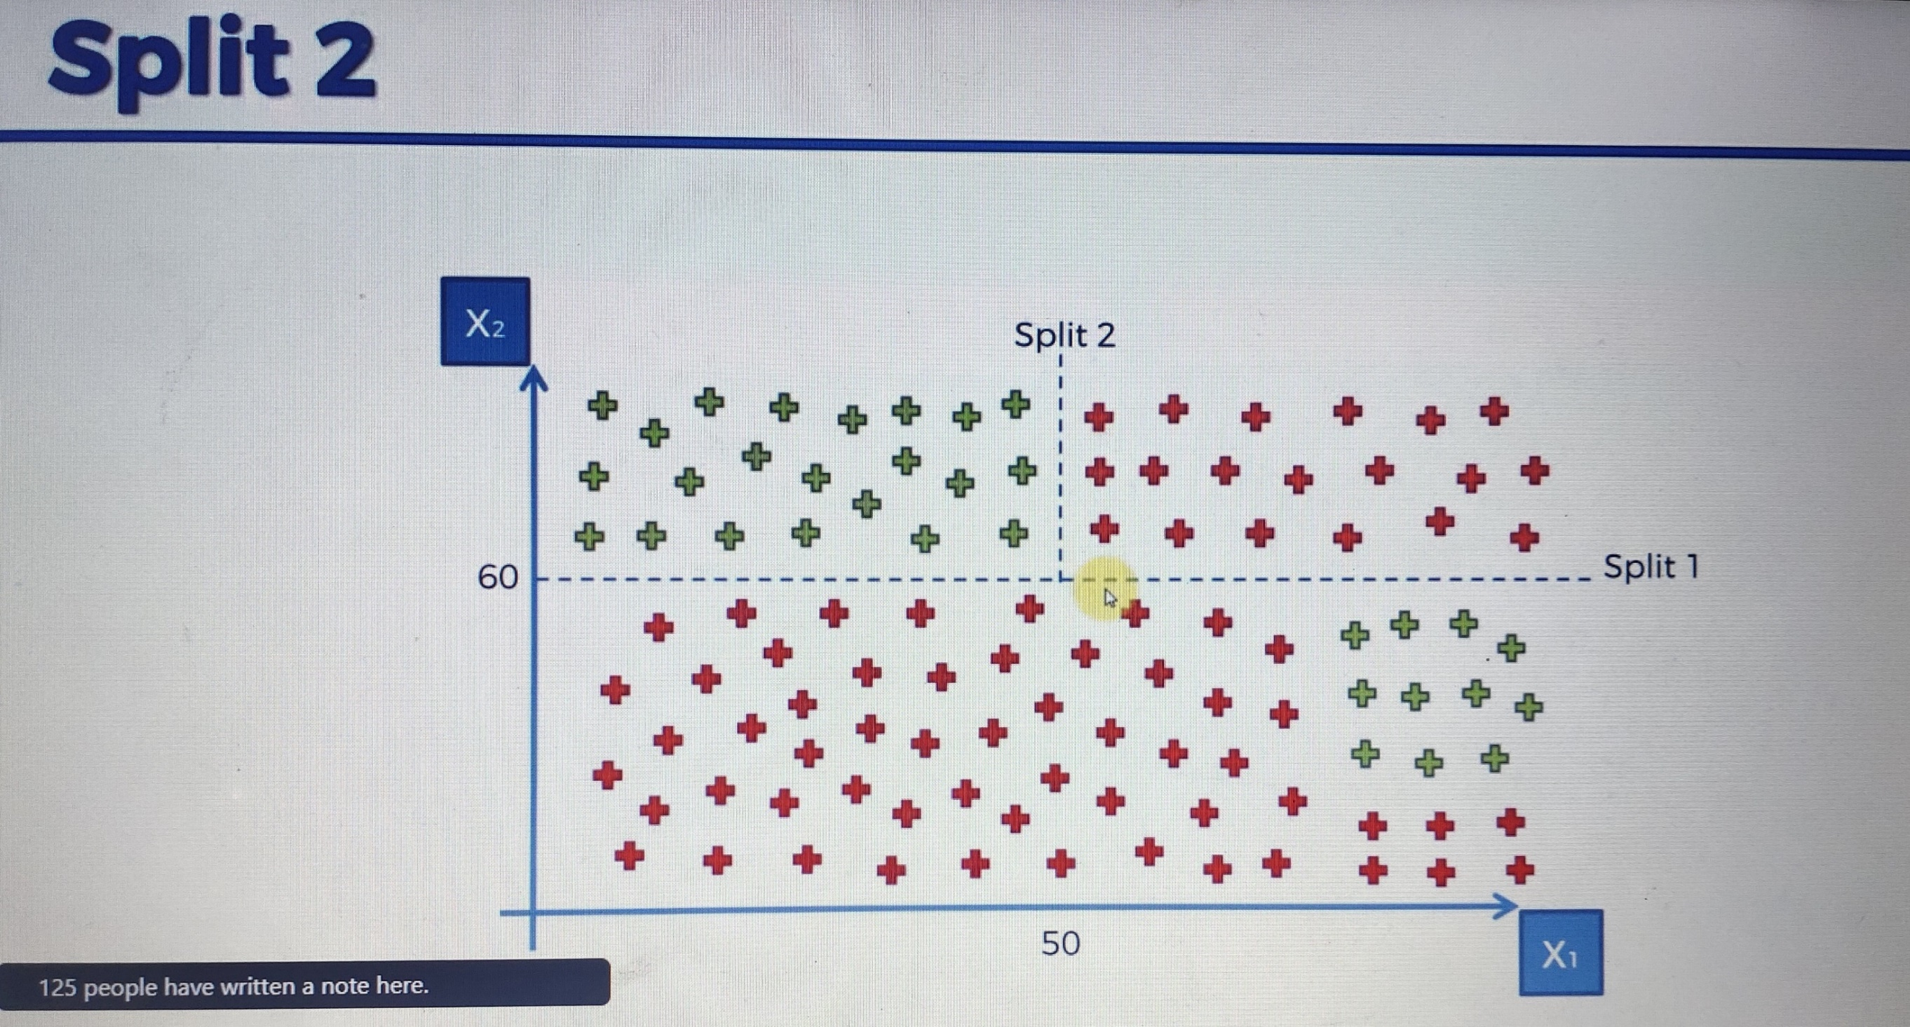
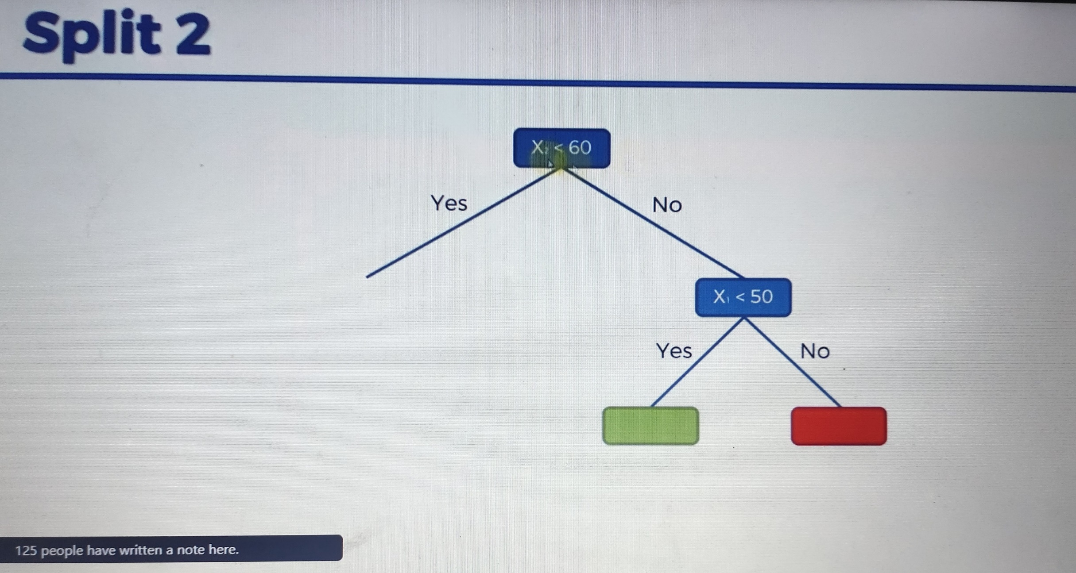

Slide 12
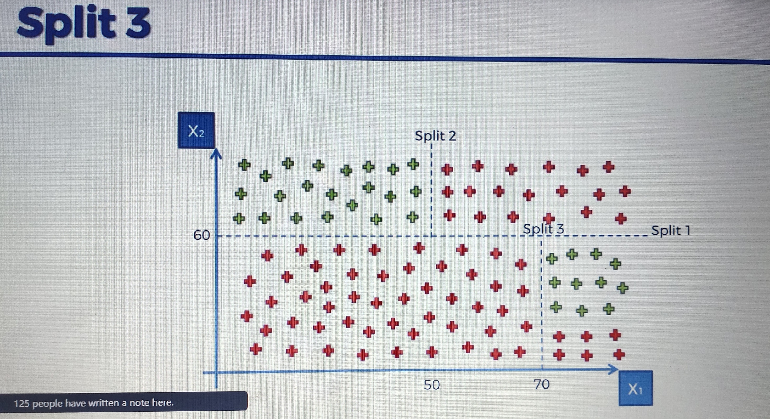
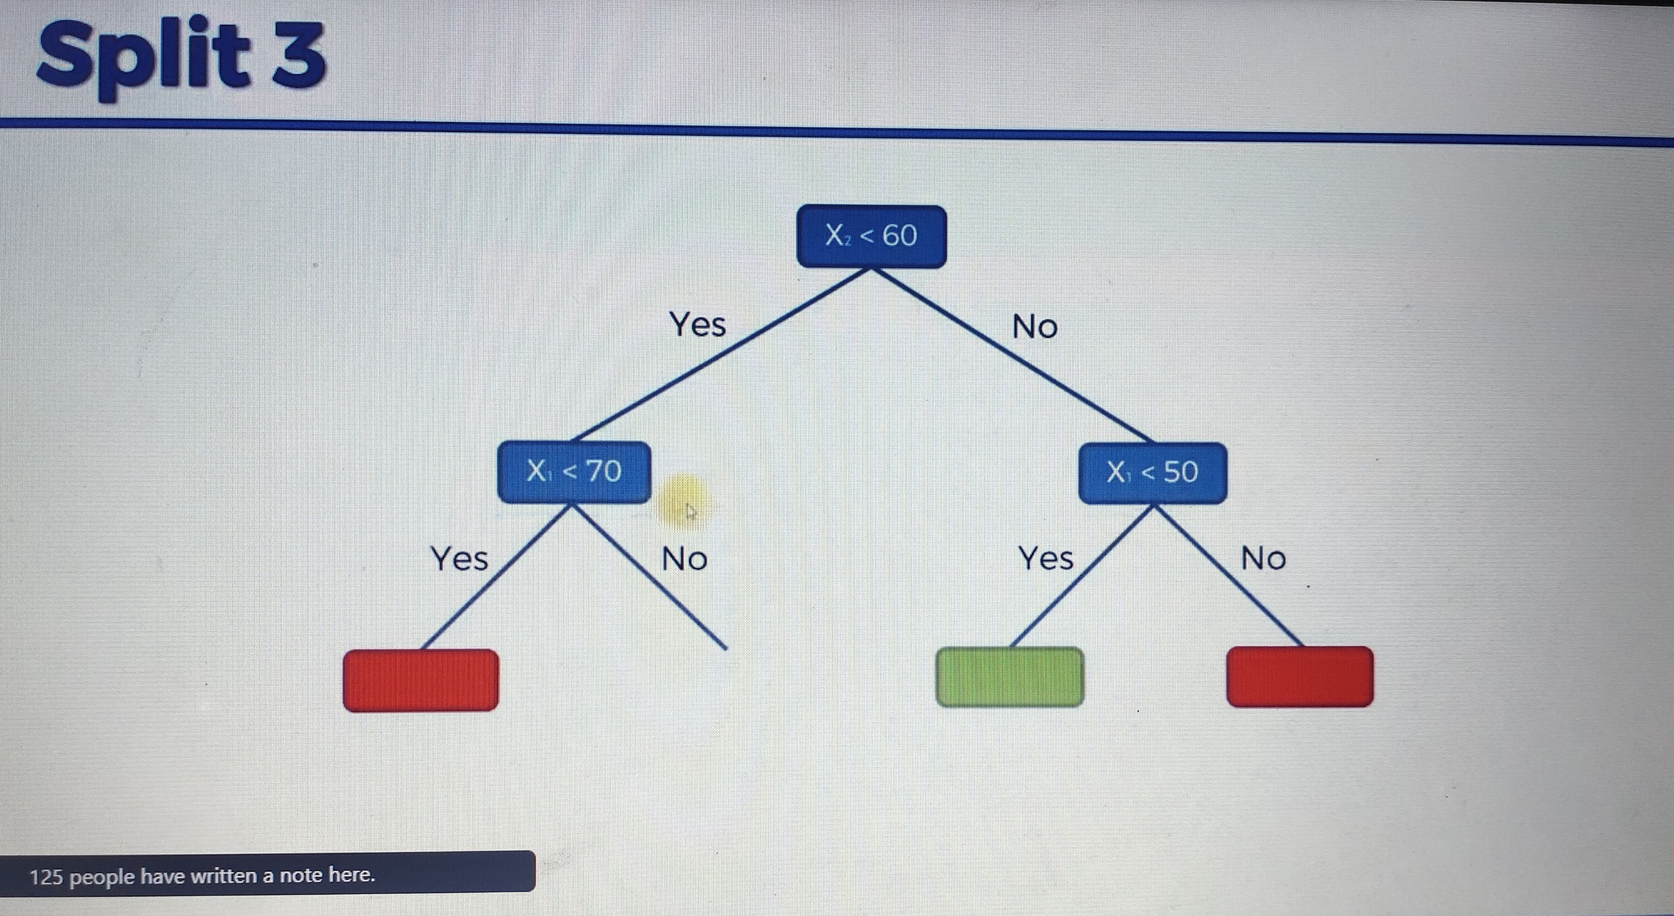

Slide 13
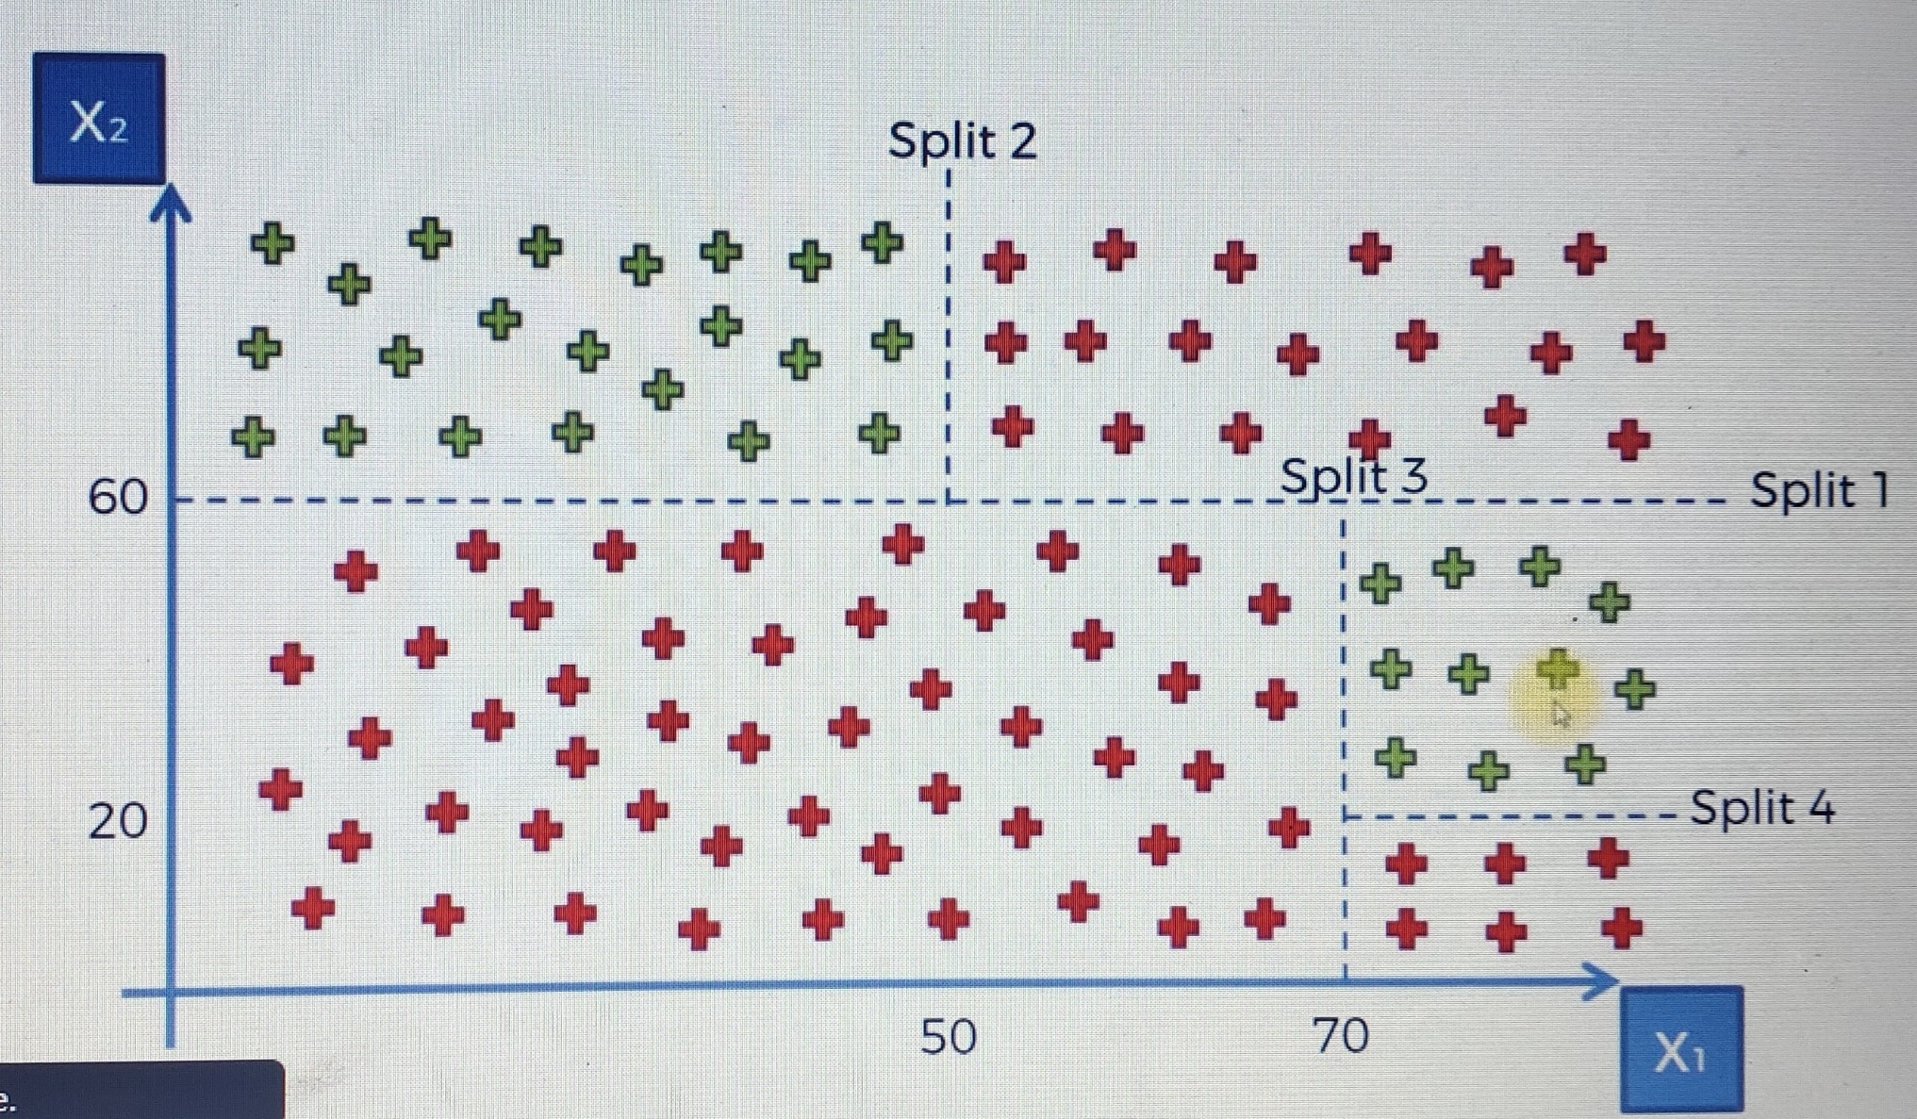

Slide 14
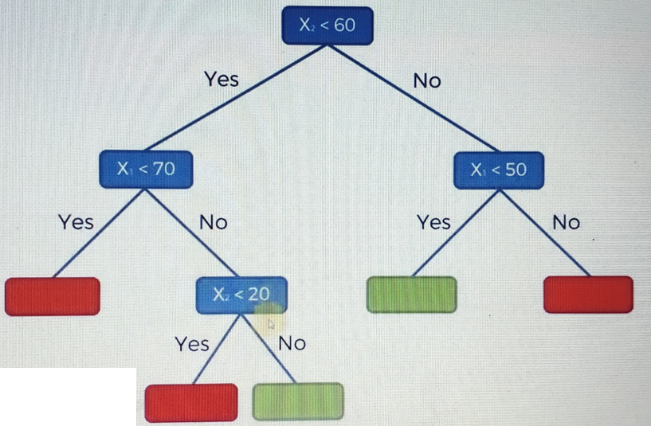
At the end of decision tree it will assign class to each leaf node and from leaf node decision will be taken particular riding will came in which class. Try your self x1=30 and x2=60 come in which class?

Slide 15
Entropy
Entropy is the measures of impurity, disorder or uncertainty in data. it is used to reduce the randomness in the data. While splitting the data into two nodes from the root node. If the child nodes hold some impurity/randomness in the data. This leads input to another child node creation. Finally, the low accuracy/noise will be provided at the end result.

Slide 16
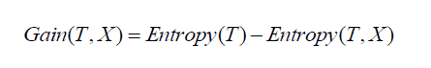
Information gain
Information gain calculates the decrease in entropy after splitting a node. It is the difference between entropies before and after the split. The more the information gain, the more entropy is removed.
Where T is the parent node before split and X is the split node from T.

